Slide 1
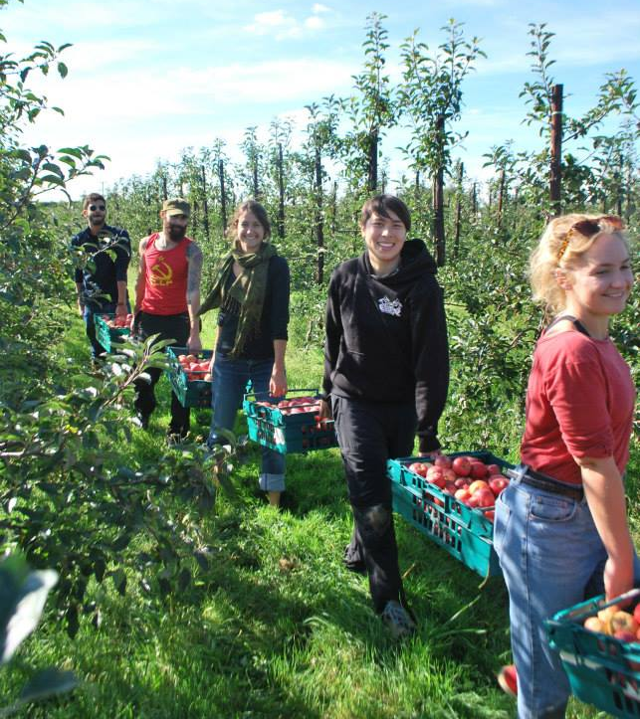
Gleaning Network EU

Slide 4
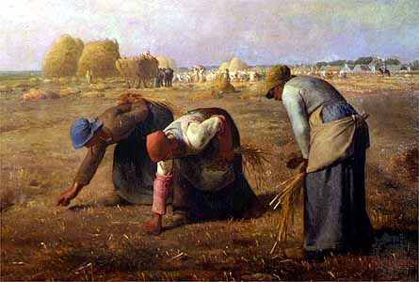
The Gleaners, Jean-François Millet (1857)

Slide 6
UK
(Gleaning Network UK / Feedback)

Slide 7
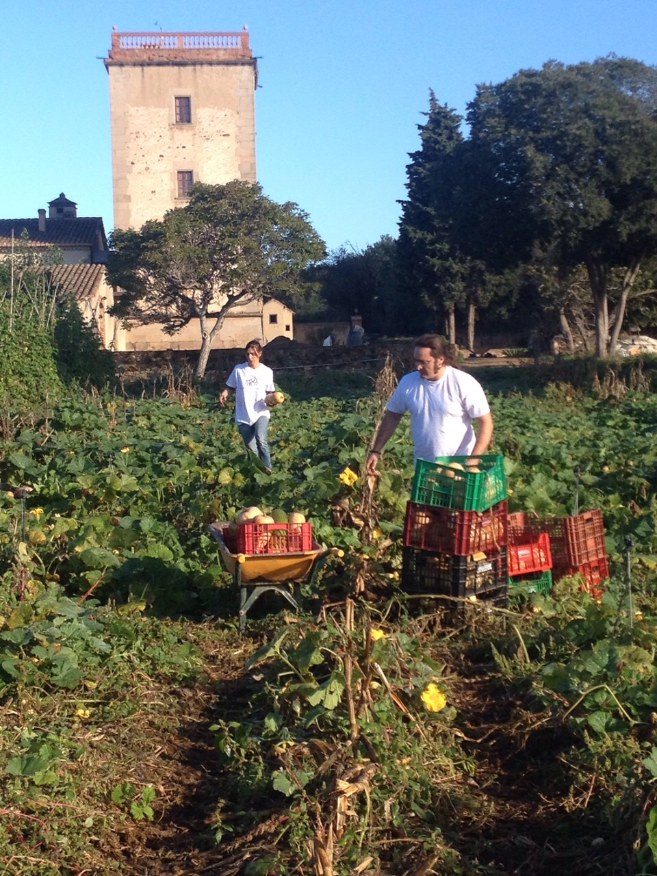
Spain (Espigoladors)

Slide 8
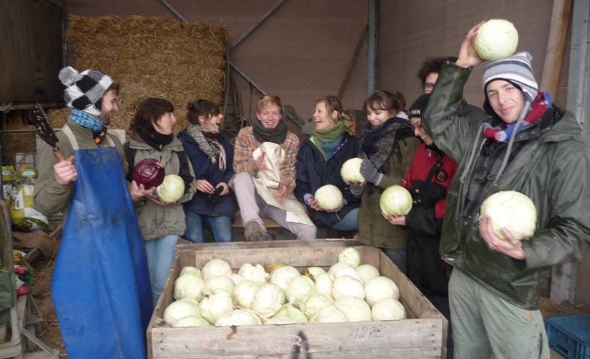
Belgium
(Gleaning Network Belgium)

Slide 9
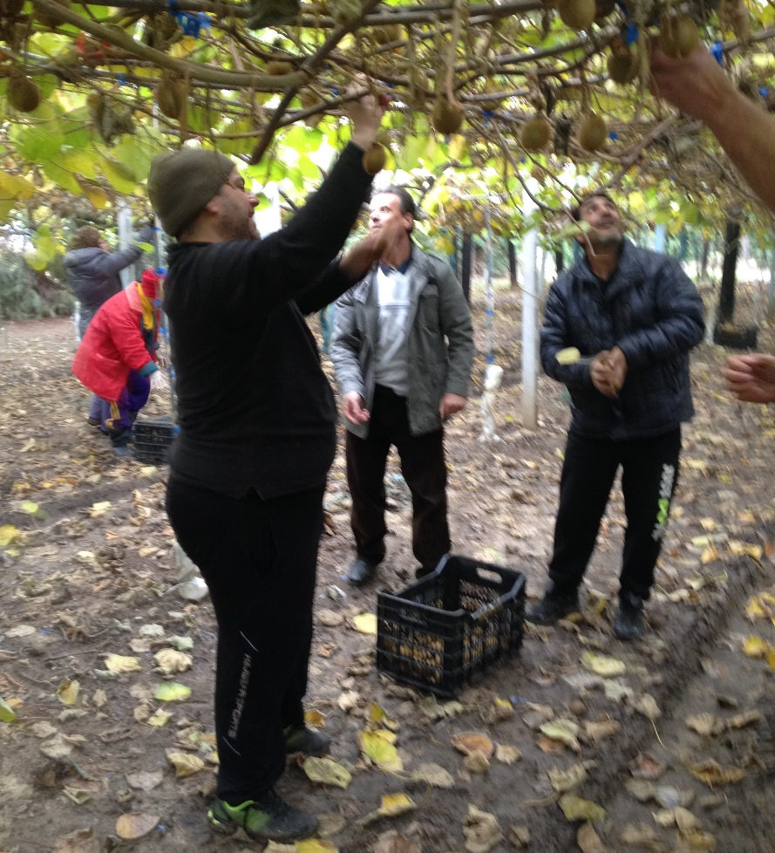
Greece
(Boroume)

Slide 10
France
(Re-Bon)

Slide 11
Gleaning Network EU
Gleaning Network EU
4 pilot projects underway: Belgium, France, Greece & Spain
Many gleaning days already carried out; further gleaning days to be undertaken throughout summer 2015
Final Evaluation will present case studies showing different operational approaches to gleaning, as demonstrated by the 4 pilot studies
Gleaning Handbook and other web-based tools under construction – due for completion in September 2015
Already seeing significant interest in gleaning from several countries outside the pilot study, including Poland, Ireland & Czech Republic

