Slide 2
Why?
Vision
Working towards a Zero Food Waste society through social innovation
(Social) innovators push the whole society with their solutions

Slide 3
How?
Mission: Steering the movement of Food Surplus Entrepreneurs
European community of Food Surplus Entrepreneurs
Goals
Exchange: learn from each other
Collaboration: connect Food Surplus Entrepreneurs into an ecosystem to tackle common chalenges
Visibility: spreading innovations to other contexts

Slide 4
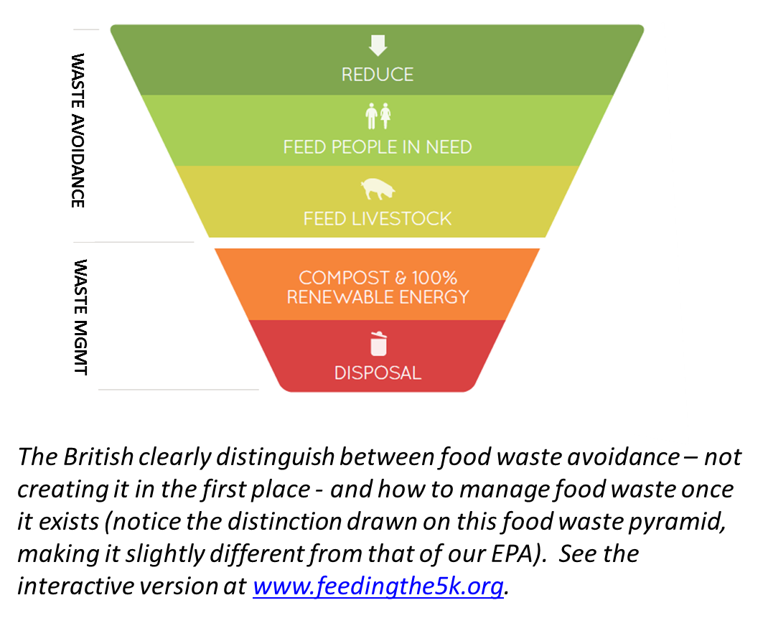
Food Waste Pyramid - Feedback
Notes:
A first guideline in this exercise is the food waste pyramid.
When we set our aim: 0% food waste to landfill, ut could be an easy solution to make gas out of all this food.
We have to be aware this is a pitfall. Food is valuable: energy, manpower, land and carbon was invested. It’s a waste to make gas out of lettuce that could be eaten by people.
The right order is shown in the FW Pyramid. Reduce, feed to people, feed to livestock. And only then compost or make gas.
The Food Waste Pyramid

Slide 5
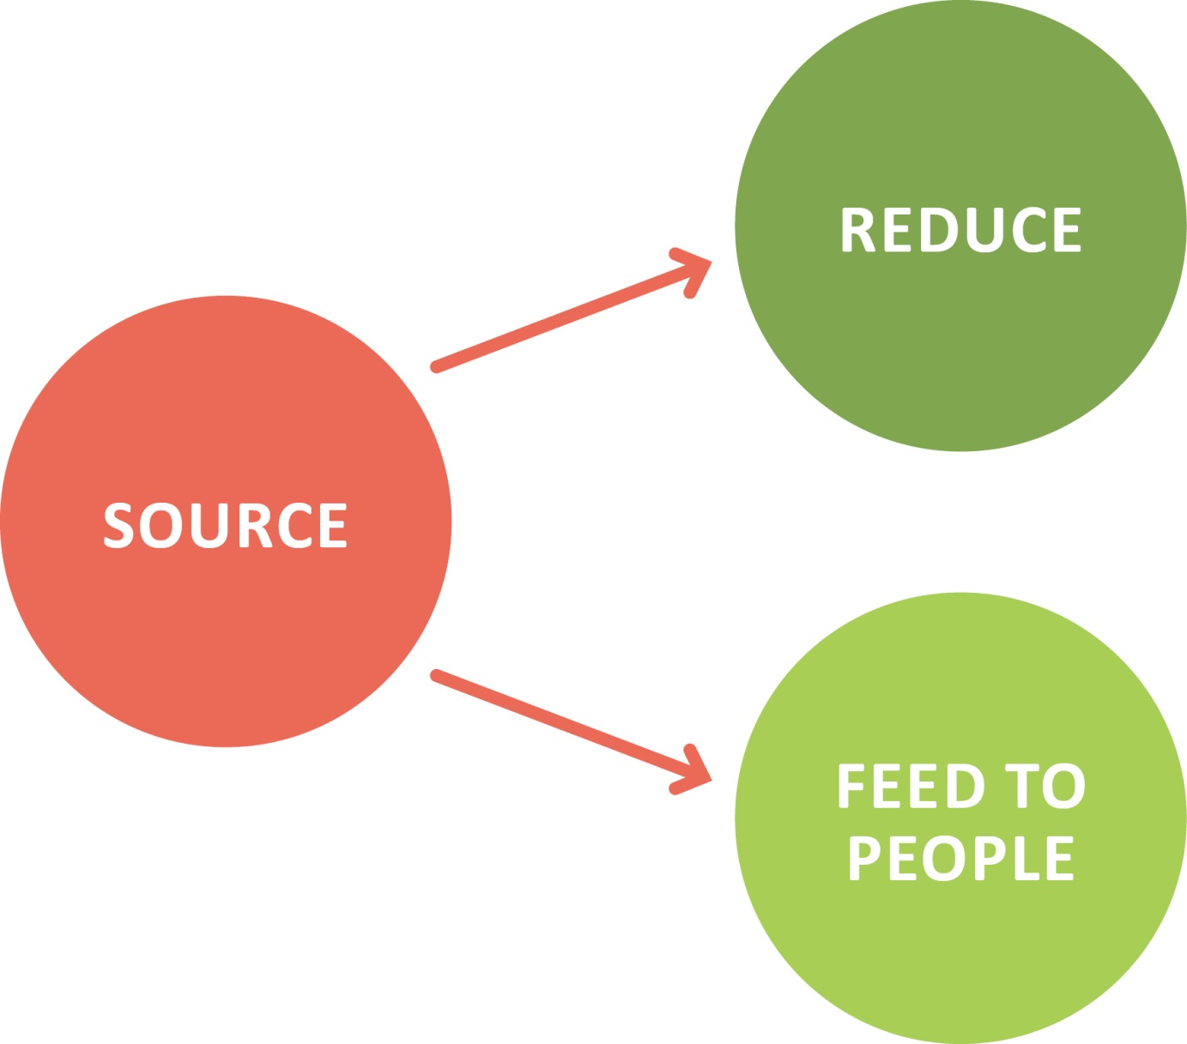
1. A System

Slide 6
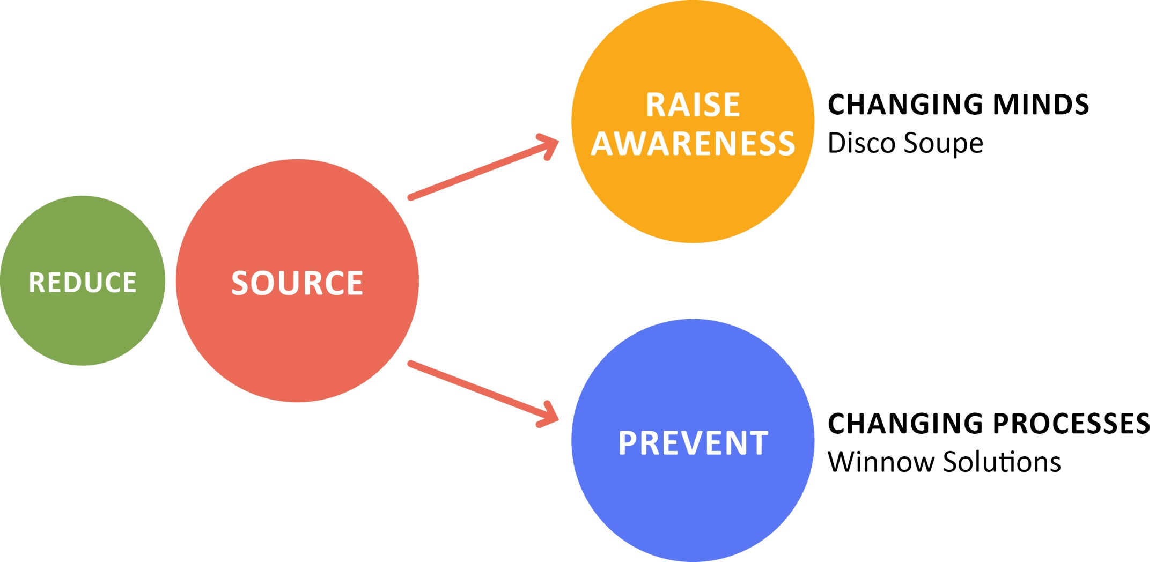
Reduce

Slide 7
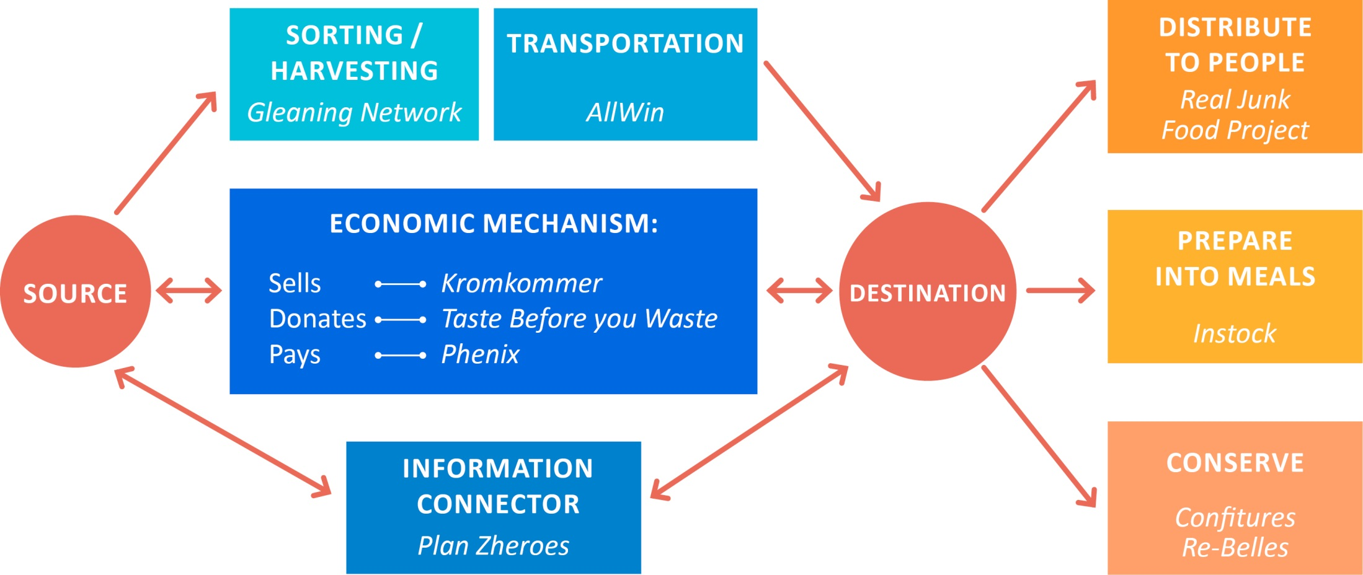
Feeding to people

Slide 8
Local Community Hubs
Where?

Slide 9
Local Community Hubs
Who?
Social innovators fighting food waste
Changemakers
Volunteer coordinator
Collaborations
Sourcing
Sharing resources
Mapping sector capacity
Offering services and products
Advising policy makers
Communication

Slide 10
Food Surplus Roundtable

Slide 11
Food Surplus Roundtable
Starting a Local Community Hub in Budapest
Thursday 4 June, 18:30-21:00
Address: 3, Három, Three, Kazinczy utca 1, 1075 Budapest, Hungary

Slide 12
Contact
www.fsenetwork.org
info@fsenetwork.org
@FSENetwork
facebook.com/FSENetwork
Food Surplus Entrepreneurs Network

