Slide 1
FUSIONS WP1: Quantification and Impacts
Silvia Scherhaufer, BOKU
Clément Tostivint, BIO
Budapest June 3, 2015

Slide 2
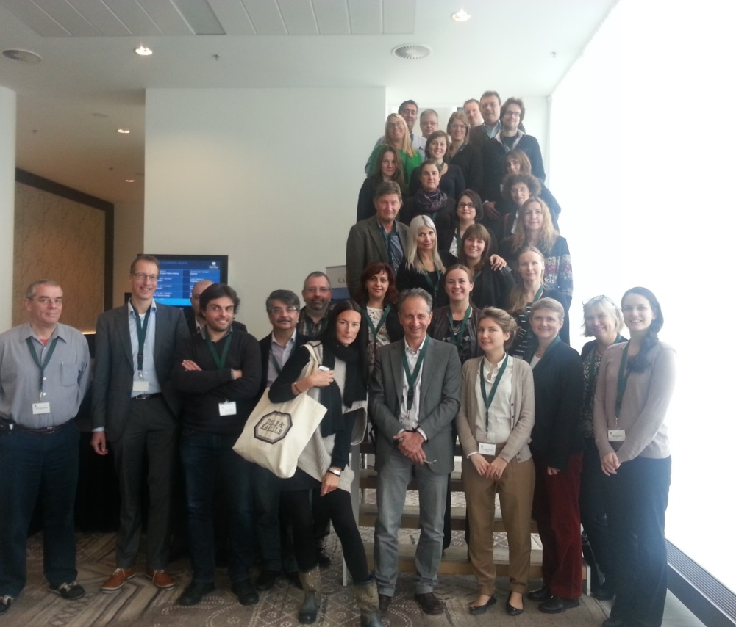
Objectives for WP1
Standard approach on system boundaries and a definition of food waste
Developing standardised reporting methodologies
Mapping existing trends in relation to food waste prevention and reduction, relevant to social innovation in the food chain,
Developing criteria for the assessment of socio-economic & environmental impacts of food waste and providing baseline estimates
Establishing a Food Waste Quantification Manual

Slide 3
Wp1 builds knowledge, develops recommendations and explores impacts
mpacts of food
waste
EU food waste levels
Developing recommendations for EU28
Building knowledge (background reports )
FUSIONS Definitional Framework for Food Waste
EUROSTATs reporting method and statistics
Review of (food) waste reporting
Food waste drivers ,and barriers and opportunities
Impacts
EU food waste levels
Reports are found at:
www.eu-fusions.org
Developing recommendations
Food waste quantification manual
Definition of Food Waste
FUSIONS Definitional Framework for Food Waste
EUROSTATs reporting method and statistics
Review of (food) waste reporting
Food waste drivers ,and barriers and opportunities
Standard approaches on quantitative techniques

Slide 4
Agenda
Survey on Food Waste EU-28
→ Discussion
Environmental , social and economic Impacts of Food Waste
→ Discussion
Food Waste Manual
→ Discussion

Slide 5
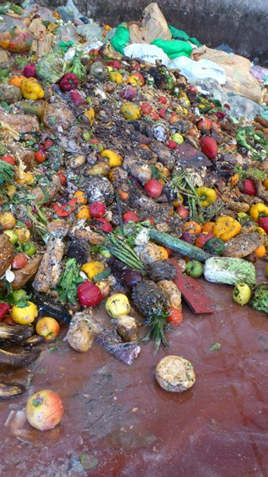
Food waste arisings in EU 28
Data collection from
FUSIONS partners
Representatives within each MS Government responsible for reporting of waste statistics
Data sources:
National waste statistics
Research studies

Slide 6
Data investigation
Scope of estimate (sector, region)
Methods
Age of the estimate
Level of uncertainty
Reasons for not inclusion in the estimations:
Extreme values without any explanation given
Several or major subsectors not being covered
Several or major waste flows not being covered.
Notes:
Data is collected from existing sources – this means that care had to be taken of used definitions, what was included in the data etc.
Collected from national statistics contact points and from FUSIONS partners according to a sent out matrix including instructions. Data has also in some cases been found in litterature.
Data asked for:
Amounts of food waste generated from different sectors in the food value chain (Annex A)
The destinations for this food waste (e.g. whether going to landfill, anaerobic digestion, etc.) (Annex B)
The amount of food waste split into different product categories (the same as listed in D1.4) (Annex C)
All data compiled, and then more detailed questions was asked to the countries that had data.

Slide 7
Data provided
Notes:
Also asked for data on redistribution – no data available

Slide 8
Compilation of the matrix
Sector | Number of countries submitting data | Number of countries submitting data of sufficient quality | NACE codes
Production | 9 | 3 | NACE 01-03
Processing | 13 | 5 | NACE 10-11
Wholesale and logistics and Retail and Markets | 10 | 6 | NACE 46 and 47
Food service | 10 | 5 | NACE 56 (55)
Household | 14 | 7 | NA
Notes:
1 Seven countries supplied data from wholesale and logistics and ten countries supplied data from the retail and market sector.
2. Five of the six countries supplying data from wholesale and logistics had sufficient data quality. Six of the seven countries supplying data from the retail and market sector had enough good quality.
A key point to make is that one of the main recommendations was to increase the number of countries submitting robust data to improve the uncertainty associated with the preliminary estimate.

Slide 9
Up-scaling to EU-28
Sector | Normalisation factor used to fill in data gaps | NACE codes
Production | Produced food amounts | NACE 01-03
Processing | Produced food amounts | NACE 10-11
Wholesale and logistics and retail and markets | Population | NACE 46-47
Food service | Turnover number | NACE 56 (55)
Household | Population | NA
Notes:
Production: produced food amounts instead of sold unit. This since it should be a rather linear correlation between the produced food amounts and the generated food waste amounts. Furthermore produced amounts are public available through Eurostat and are updated on a continuous basis.
Processing: produced food amounts instead of amount of food sold. As with the production sector the strategy was to choose a normalisation factor which correlates to the generated food waste amounts as much as possible. Also the public availability and the updating of data was another reason why the produced food amounts was chosen.
Wholesale and retail: population instead of turnover or amount of sold products. This since data on turnover number was not available exclusively for wholesale and retail related to the selling of food product but for all types of products. As it should be a correlation between the food waste amounts produced from the sector and the population is was decided to use population as a normalisation factor, which also is public available and updated on a regular basis by Eurostat.
Food service: turnover instead of amounts of food served. This as no public information about food amounts produced from the sector was found in the project. Based on discussions in the project, there should be a correlation between the food waste amounts and the turnover number taking into account the different price levels between EU countries.

Slide 10
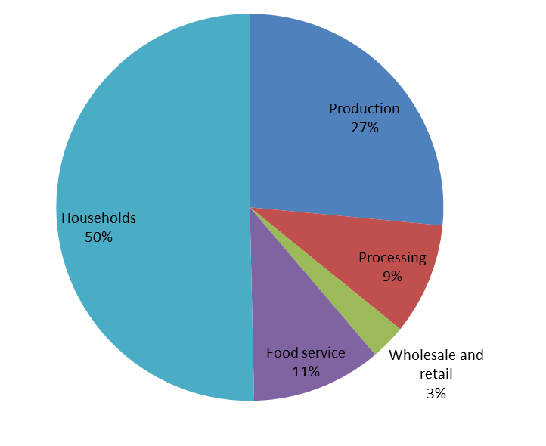
What did we get…
Notes:
A key point to make is that one of the main recommendations was to increase the number of countries submitting robust data to improve the uncertainty associated with the preliminary estimate.
Food waste (million tonnes) with 95% confidence intervals
Food waste (kg per person) with 95% CI
Production
25.7 ± 13.8
51 ± 27
Processing
9.2 ± 2.1
18 ± 4
Wholesale and retail
2.9 ± 0.4
6 ± 1
Food service
10.7 ± 3.4
21 ± 7
Households
49.6 ± 8.0
98 ± 16
Total food waste
98.1 ± 16.4
194 ± 32

Slide 11
Uncertainties
Differences in the definition of food waste
consideration of by-products and animal feed in data especially within production and processing sector
This can also change due to market conditions
Differences of countries with high and low GDP
Countries with robust data were largely in the north and west of Europe
This may not be fully representative for the rest of EU-28

Slide 12
Future outlook
Updating calculation in autumn 2015 → new studies will be included
Assistance for MS to a more reliable reporting → FUSIONS food waste quantification manual

Slide 13
Discussion
Data available?
Other questions

Slide 14
Environmental, social and economic impacts
Approach of FUSIONS
Environmental
Social
Economic
Bottom-up: from products up to total fw impacts Top-down: from aggregated statistics down to total fw impacts | Impacts on health and nutrition issues Impacts on food banks and other initiatives | Impacts on global food prices
Agriculture, Production
Processing
Wholesale & Retail
Consump-tion
End of Life

Slide 15
Indicator products for impact assessment
Chosen indicator products:
Bread, Potatoes, Tomatoes, Apples, Milk, Beef, Pork, Chicken, White Fish
Representativeness:

Slide 16
Environmental impact - Approach
Data inventory for the bottom-up approach:
kg CO₂-Equivalents per indicator product for each step of the supply chain from extensive literature research (more than 110 sources)
End of Life phase is not covered in most of the literature
Food waste recovery and disposal operations were quantified

Slide 17
Environmental impact – Intermediate results
Agricutlture, Production
Processing
Wholesale & Retail
Consump-tion
End of Life

Slide 18
Data gaps
Food waste amounts on aggregated level for the whole supply chain
Quantification in preliminary stage available from FUSIONS
Level of detail is insufficient for impact assessment
Food waste amounts on product level based on estimation by Gustavsson et al., 2013 was conducted to proceed further

Slide 19
Impacts on health and nutrition issues
Estimation of impact:
Nutritional data from 3 national Food Composition Nutrient Databases: NL, UK, Sw, (USA: amino acids*)
Selected nutrients: vitamin A (relation with nutrient deficiency), beta-carotene, vitamin C and fibre. Optional: iron, zinc, n-3 fatty acids, lysine* and methionine*
Amounts of wasted products
Food waste amounts in EU (totals) from T1.6
Translation of total waste amounts to food categories and to indicator product (groups) using FAO Food Balance Sheets Luke&Boku
To consider: Nutritional data are on a product level, therefore FLW data are needed on a product level as well. As these data are not available, the results will be ESTIMATIONS based on average nutrient composition of the indicator product food groups
Notes:
NL (Dutch Food Composition Database: NEVO), UK (McCance and Widdowson’s The Composition of Foods integrated dataset :CoF IDS) and Sweden (The Food Database)
* Amino acids, Only in USA database (USDA National Nutrient Database for Standard Reference)

Slide 20
Impacts on health and nutrition issues
Assumptions:
Nutritional data from food composition databases are an estimate for the nutrient composition of waste/inedible parts from the (indicator) food products. This will be an overestimation for the nutrient content of waste.
Estimated amounts of wasted (indicator) product groups are representative for total FLW
Calculation/estimation of the impact on nutrient composition will follow soon

Slide 21
Social impacts of food banks and food redistribution initiatives
Background: food redistribution initiatives have several (positive and negative) socio-economic implications.
Objectives
Identify the
relevant impacts
Develop a methodology to assess the social impacts (i.e. the pursuit or achievement of improvements in the lives of social groups) of food redistribution initiatives
Test the methodology through a pilot survey

Slide 22
Social impacts of food banks and food redistribution initiatives
Preliminary results
Obj 1. The literature review suggested 123 different positive and negative socio-economic impacts associated to food redistribution initiatives.
Obj 2. The methodology to assess social capital was based on the approach developed by the World Bank in 2004 (Grootaert C., Narayan D., Nyhan Jones V., Woolcock M., (2004), Measuring Social Capital. An integrated Questionnaire, Working Paper n. 18, The World Bank, Washington D.C.
Social capital is defined as a set of behavioral norms that increase cooperation and trust leading to an improvement of the community welfare.

Slide 23
Social impacts of food banks and food redistribution initiatives
Obj 3. A survey was distributed to over 200 European food redistribution activities to quantify the six dimensions that constitute the basis for the social capital assessment.
Groups and networks
Trust and solidarity
Collective action and cooperation
Social cohesion and inclusion
Information and communication
Food security and food safety
Social capital

Slide 24
Impacts on global food prices
Three-step process:
Theoratical Framework on the economics of FLW
Study by University of Bologna research team (2013,FAO Funds)
Macro-economics e.g. Inflation; trade at national/regional/global levels
Micro-economic conditions e.g. Utility and profit maximization
Non-economic conditions e.g. Social norms, policies, climate
Modelling and Quantifying impacts FLW reduction
FAO-LEI Study (2014, FAO Funds)
The Impacts of Reducing Food loss and Waste in the EU on Sub-Saharan Africa. A focus on food prices and price transmission effects.
Scenario analysis using CGE model- MAGNET

Slide 25
Impacts on global food prices
Synthesis report based on (1) and (2)
Report by FAO for FUSIONS (2015, FUSIONS funds)
Socio-economic impacts of food loss and waste prevention and reduction in the EU. Comparative analysis of knowledge available to date
Key results/ insights
Complex interactions between supply and demand shifts are a challenge for modelling impacts
Market prices decrease but by less than 100%; more welfare gains in region/ country making reduction intervention
Data gaps: new estimates of FLW & costs of intervention measures

Slide 26
Outlook
Deliverable on impacts will be published in autumn 2015
Focus on methodological approach in FUSIONS, data quality and data gaps

Slide 27
Discussion
Questions

Slide 28
Thank you for your attention!
Questions?
Silvia Scherhaufer | Clément Tostivint
BOKU University of Natural Resources and Life Sciences, Institute of Waste Management Vienna, Austria | BIO by Deloitte Sustainability Services | Deloitte Conseil Paris, France
silvia.scherhaufer@boku.ac.at | CTostivint@bio.deloitte.fr

Slide 30
FUSIONS theoretical framework
Food
Inedible parts

