Slide 1
Food. Waste?
Henrietta Magyar
Stakeholder Relations Manager,
Tesco Hungary

Slide 2
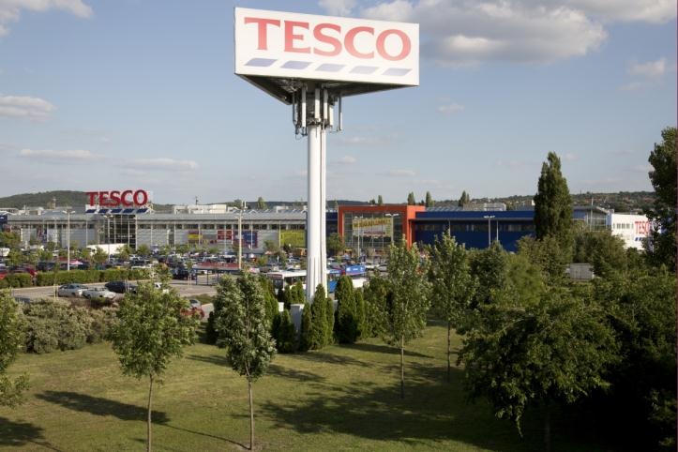
About Tesco
Retail industry – food
1996
209 stores, 118 cities
3 million customers every week
Working closely with local suppliers
Focus areas of corporate responsibility:
Promoting healthy lifestyle
Supporting the development of young people
TACKLING FOODWASTE – with Foodbank

Slide 3
Partnership with Foodbank in Hungary
Different level of expectations:
Internal TL&T processes and rules – local consumer protection regulations
How:
Cooperation Agreement
Authority (NÉBIH) informed and involved
Cross-functional development: TL&T, Step Change
Additional operation procedures
Selection of stores
Now:
Bakery: morning collection from Mon-Fri, delivery to organizations the same day
All sorts of food: evening before closing days (Saturdays or national holidays)

Slide 4
Partnership with Foodbank in Hungary
1.) Pilot (2014/15 H1)
- Budapest Köki és Váci street
- effective operations
- authority approcal
2.)
MONTH | NR OF STORES | AMOUNT
September 2014 | 5 | 4 278 kg
October 2014 | 16 | 14 917 kg
November 2014 | 26 | 25 636 kg
December 2014 | 26 | 35 181 kg
January 2015 | 26 | 22 235 kg
February 2015 | 26 | 20 080 kg
March 2015 | 25 | 24 779 kg
April 2015 | 34 | 30 251 kg
TOTAL | 34 | 177 807 kg

Slide 5
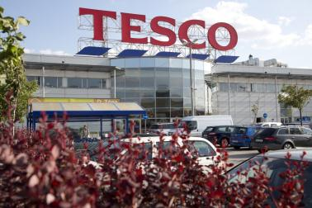
Partnership with Foodbank in Hungary
3.) Plans for 2015/16

Slide 6
Challenges
Optimal timing for both parties
Processes (logistics, administration, training etc.)
Safety
NGO partners
Internal communications

Slide 7
Make it sustainable
Win-win for all parties
True partnership, regular dialogue, understanding each other
Not one-off project rather long-term planning
Financially sustainable process
„Business approach” from NGOs, „not-for-profit approach” from Tesco

Slide 8
