Slide 1
EU policy measures for food waste prevention through social innovation
Silvia Gaiani (UNIBO)
FUSIONS RPM in Budapest
Budapest, June 3rd

Slide 2
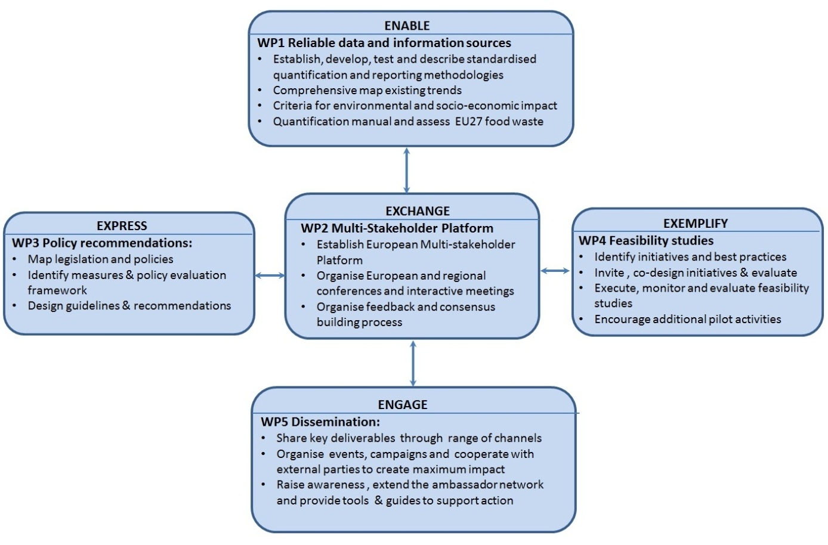
FUSIONS_Food Use for Social Innovation by Optimising Waste Prevention Strategies: STRUCTURE

Slide 3
FUSIONS’s policy work: Background
European policy measures for FW prevention and reduction
Through social innovation
Policy is a course or principle of action, proposed or adopted by a government, party, business or individual, intended to influence and determine coherent decisions, actions, and other matters; usually with a common long-term purpose(s).
SI has socially recognised goals (in this case, reducing food waste).
SI is grounded in deep reflection on the problem & direct action from those involved in it. It represents co-creation and learning.
SI is people-focused, both in terms of its delivery & its beneficiaries. This aids its diffusion or institutionalisation.
SI is delivered through, and builds capacity for, relationships and collaboration – often through a multi-stakeholder approach. It affects the process of social interactions.
SI is a new combination of activities and / or delivered into a new setting.
SOURCE: Australian Concise Oxford Dictionary, The Free Dictionary and FAO Corporate Document.
SOURCE: «How can social innovation help reduce food waste?”
FUSIONS WP4

Slide 4
FUSIONS’s policy work: Objectives
1. Contribute to policy making at both the European and Member State levels
3. Draft recommendations for a Common Food Waste Policy in the EU28 with focus on social innovation
2. Identify policy tools to stimulate socially innovative solutions to address food waste
What policy changes at the EU and Member State level to deliver a 30% reduction by 2025 (or more if the new circular economy package will be more ambitious?)

Slide 5
Approach
May 2016 Recommendations for a Common European Food Waste Policy with focus on social innovation
D3.2
July 2014
Social Innovation Camp and comprehensive set of measures
D3.1
March 2015 and onward
Review of legislation and policies impacting food waste generation at the EU and Member States levels
D3.3
June 2015
Policies challenging food waste through social innovation
D3.4 September 2015
Evaluation Framework
D3.5 May 2016
a. Guidelines
b. Scenario analysis
Analysis
Define the Problem
Assemble Some Evidence
Construct the Alternatives
Select the Criteria
Project the Outcomes
Confront the Trade-offs
Decide
Tell Your Story
Eightfold Path
Analitical tools
Continue data collection and update
i.e. web-consultations on country reports
Data collection

Slide 6
D3.1a Review of EU legislation and policies with implications on food waste
Legislation and policies addressing food waste are multilevel and multisectoral; therefore, there are multiple - and not always explicit - policy effects to be considered…
20 legislative acts potentially implying food waste generation
5 legislative acts potentially implying food waste management
14 legislative acts potentially implying food waste reduction
5 legislative acts potentially implying food use optimization
9 legislative acts with more than one implication
Results: 53 EU legislative acts in force with implications on food waste were identified

Slide 7
D3.1b Review of EU Member States legislation and policies addressing food waste
National FW reduction/
prevention plans
Market based instruments
Regulatory schemes
Voluntary and negotiated agreements
Comm campaigns
Scientific reports and articles
Projects and other measures
Country reports for all the MSs.
Policy matrix
FW
policy mix
Comparative analysis
Best practice identification

Slide 8
D3.2 Social Innovation Camp and comprehensive set of measures on which to build policy strategies
Pre-Camp Survey and Pre-Camp Workshop
The Pre-Camp Survey was planned as a preparatory activity for the FUSIONS Social Camp to stimulate discussion about policies which could support social innovation for food waste reduction and prevention.
The Pre-Camp workshop was aimed to initiate a dialogue focusing on policy tools to stimulate social innovation addressing food waste prevention and reduction and to prepare and facilitate the work in the FUSIONS CAMP..
The FUSIONS Social Camp
The FUSIONS Camp was aimed at discussing with stakeholders, researchers and policy makers, how the different European policies (Social Innovation, Environment, Corporate Social Responsibility and beyond) could stimulate social innovation addressing food waste reduction.
The position paper: Stimulating social innovation through policy measures
The position paper was aimed to understand which policy measures might best support the creation, use and scaling of social innovation initiatives
Finalized

Slide 9
D3.3 Policies and improved legislation challenging food waste through social innovation
Obj 1. Exploring the potential of market based instruments and socio-economic incentives as specific policy measures for stimulating food supply-chain operators, retailers, food services, and households to food waste prevention and reduction
Obj 2. To build a comprehensive set of measures to design policy strategies stimulating social invention measures addressing food waste

Slide 10
D3.4 Indicators and criteria for a food waste policy Evaluation Framework
As policy strategies and measures and initiatives addressed to food waste reduction are growing a greater need for their analysis and for more effective monitoring and evaluation activities emerges.
Obj. Indicators and criteria to assess the effects of policy measures to prevent and reduce food waste will be formulated within a coherent Evaluation Framework aimed at providing decision makers with an effective tool for formulating and refining policies on food waste prevention thought social innovation.

Slide 11
D3.5 Recommendations and guidelines for a Common European Food Waste Policy
Obj1. Guidelines for a European Common Food Waste Policy enhancing food waste prevention and reduction through social innovation
Including:
(i) General objectives and priorities for a Common Food Waste policy;
(ii) Proposals to adapt and harmonize current legislations and food waste monitoring;
(iii) Guidelines for new Common measures promoting social innovation in the food waste sector;
(iv) Criteria for the Common Policy assessment.
Obj2. Scenario analysis on current trends of food waste generation
A qualitative comparative analysis will be developed to assess a number of alternative scenarios (business as usual, intermediate, radical improvement) focusing on different policy interventions.

Slide 12
FUSIONS RPM Consultation sessions
1) What policy measures or changes to current measures could stimulate and create an enabling environment for the recovery and the donation of unsold/unused food?
2) France just signed a new law to force supermarkets to donate unwanted food to charity. Shall other EU countries follow the example of France? What are the major barriers to extend this law to other countries?
3) What is the role for negotiated and voluntary agreements in supporting/stimulating food donation‎?

Slide 13
Thank you for your attention! Silvia Gaiani University of Bologna - FUSIONS WP3 silvia.gaiani2@unibo.it www.eu-fusions.org
Thanks

