Slide 1
Food service and hospitality surplus redistribution
Balázs Cseh
Hungarian Food Bank Association

Slide 2
What we knew
There is a big amount a wasted food in the sector
There is a strong need by people in need
Traditional (centralised) foodbanking model cannot be used

Slide 3
What we didn’t know
How to adapt/apply relevant food safety requirements?
Are there any optimal redistribution and process models providing good ROI on redistribution?

Slide 4
What we did/do
Searched and visited/analysed existing initiatives
Checked EU and some national regulations/adaptations
Looked at the potential adaptation of redistribution processes of packaged surplus food
Started a local pilot to test logistics
Checked interest on potential donor and recipient side
Preparing guidance document
Planning phase II. – potential roll-out of the project

Slide 5
Redistribution models
Occasional
Application automated
Dispached
Foodsharing
Regular
Managed / operated
Managed / not operated
Facilitated

Slide 6
Process models
Type
Kitchen - person
Kitchen - kitchen - person
Kitchen - distribution - person
Temperature chains
Hot - hot
Cold - hot
Hot - cold - hot

Slide 7
Food safety
Redistribution within the current EU legislation framework is feasible
Some national adaptations exist - with high variation
General EU level guidance with national adaptations would be a big help
Complex risk assesement is needed also including the „risk of not eating”

Slide 8
Interest of actors
There are a number of potential early adopters
Donors need assurance they are „on the safe side”
Clear interest from the charity side but flexibility and resources are limited

Slide 9
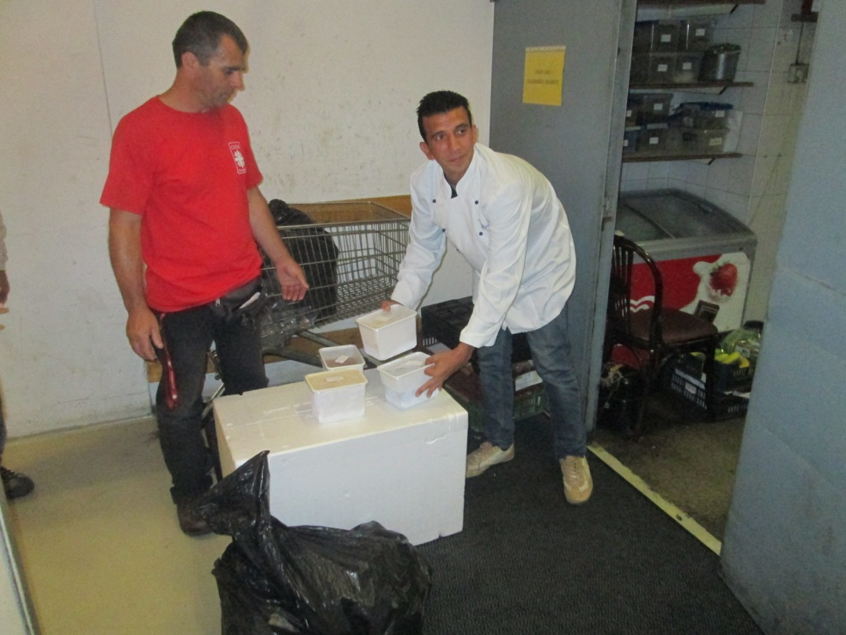
Pilot

Slide 10
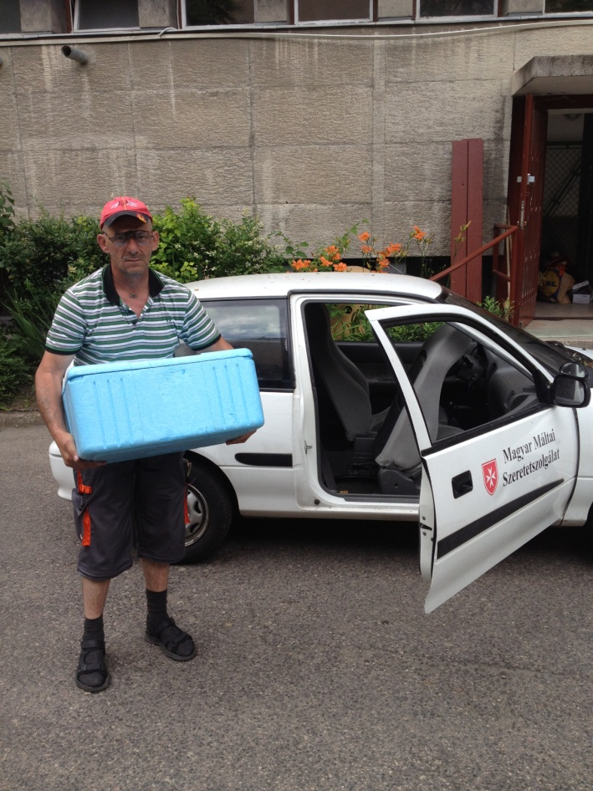
Pilot

Slide 11
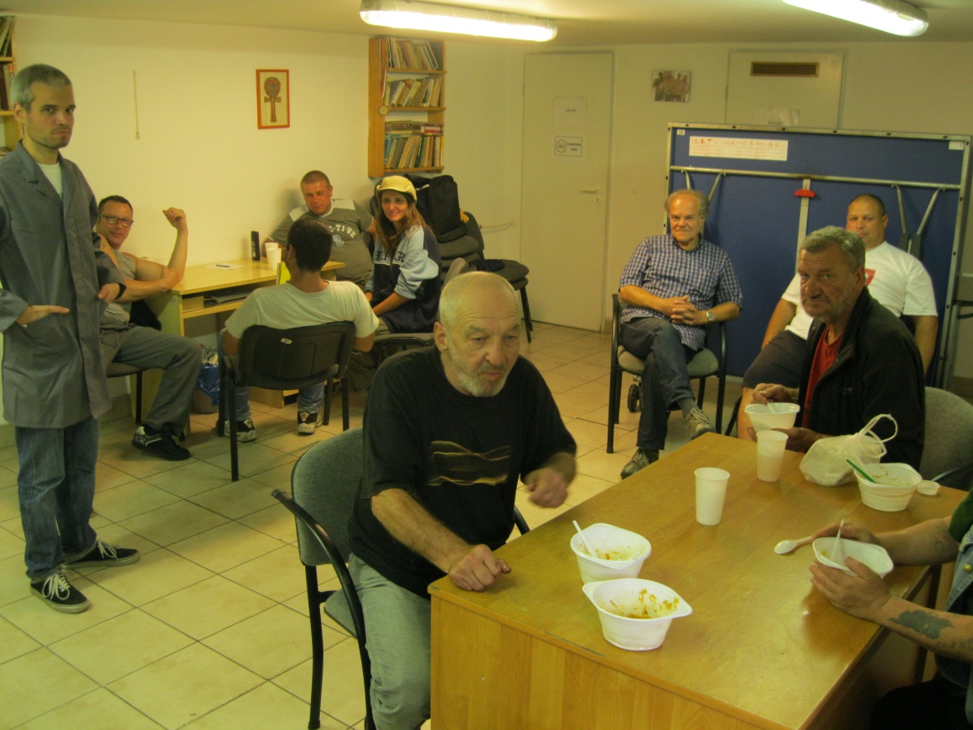
Pilot

Slide 12
Main learnings
There is clear feasibility and a very high potential for growth in the domain
Guidance on special/adapted processes is essential
„Matchmakers” are key actors
The potential ROI is very high but financial sustanability is still an issue

